Slide 1


Capstone Project IMDB Data from 2006 to 2016 using python pandas
NAME : DATLA BHAVANI CHANDRA VARMA
COLLEGE : S.R.M UNIVERSITY
AICTE ID: STU65b5eea6ac8a61706421926
Email ID : chandravarmadatla@gmail.com
AICTE
AICTE

Slide 2
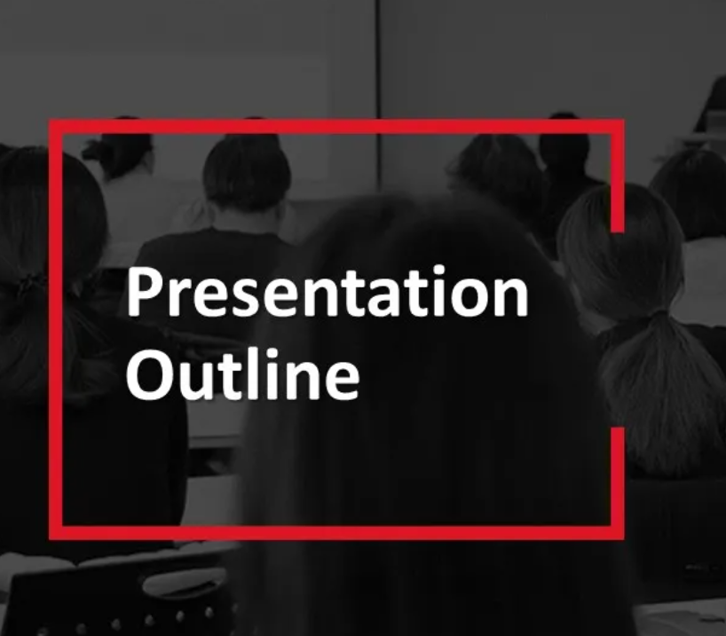
Outlines
Problem statement
Proposed solution
implementing of data sets
System approach
Statistical techniques
Result
Conclusion
Future scope
Reference
Cerficiate's

Slide 3

IMDB Data from 2006 to 2016 a data set of 1000 popular movies on Imdb in the last 10 years. Using a dataset that consist of 1000 popular movie to investigate the relationship and explore the data using exploratory data analytics and python pandas

Slide 4

Proposed solution
The proposed solution aim to address the challege of IMDB Data from 2006 to 2016 a data set of 1000 popular movies on Imdb in the last 10 years.
Data collection: gather the IMDB Data from 2006 to 2016 Data from 2006 to 2016 data from kaggle.com
Exploratory Data Analysis (EDA)
Exploratory Data Analysis (EDA) refers to the method of studying and exploring record sets to apprehend their predominant traits, discover patterns, locate outliers, and identify relationships between variables
Statistical techniques: Statistical techniques use measurements to approximate a model. In this project is,
data=pd.read_csv('IMDB-Movie-Data.csv') for dataset
data.head(10) Dispaly top 10 Rows of the dataset and etc,..

Slide 5
Proposed solution
Pandas are the most popular python library that is used for data analysis. It provides highly optimized performance with back-end source code purely written in C or Python. Here I am using python.
Creating Pandas
import pandas as pd
import seaborn as sns
import matplotlib.pyplot as plt

Slide 6
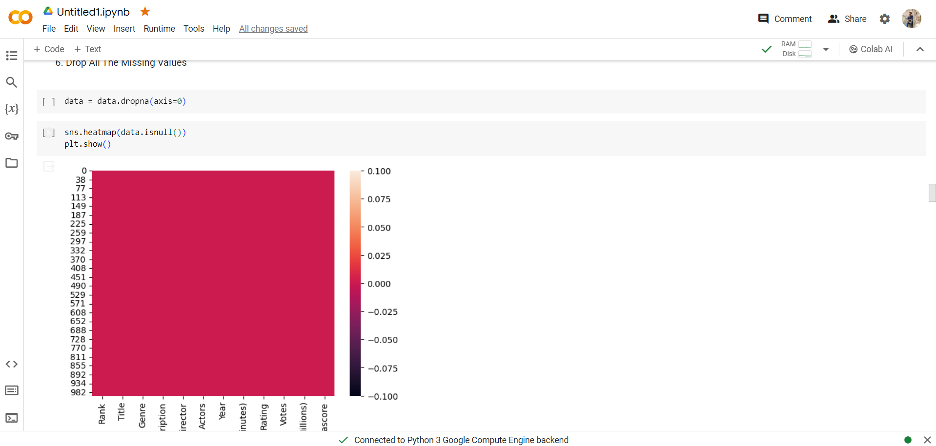
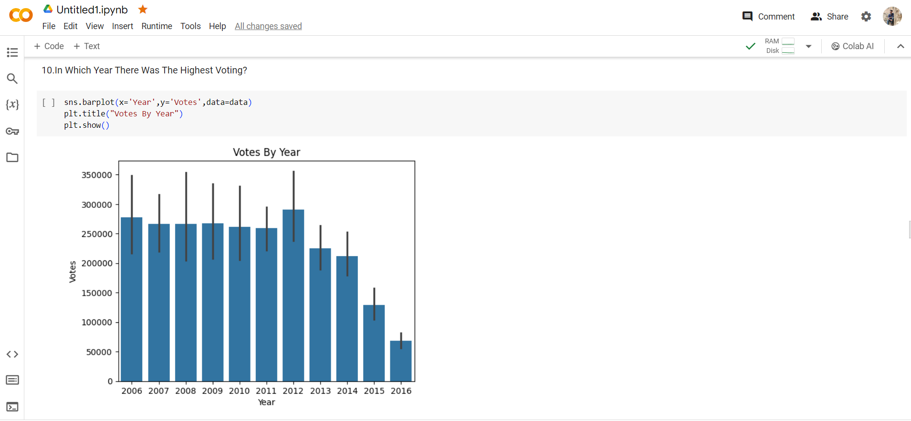
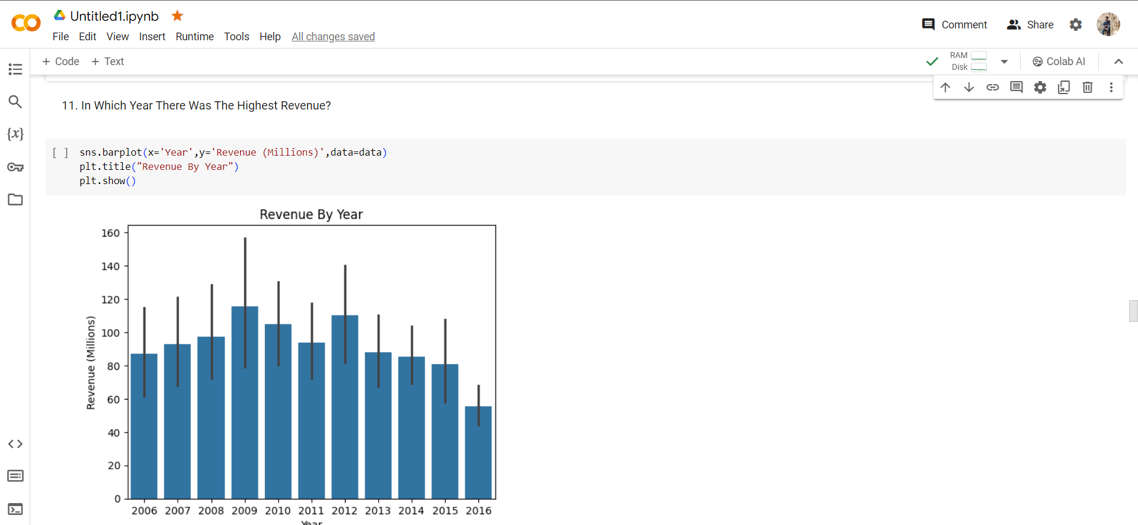
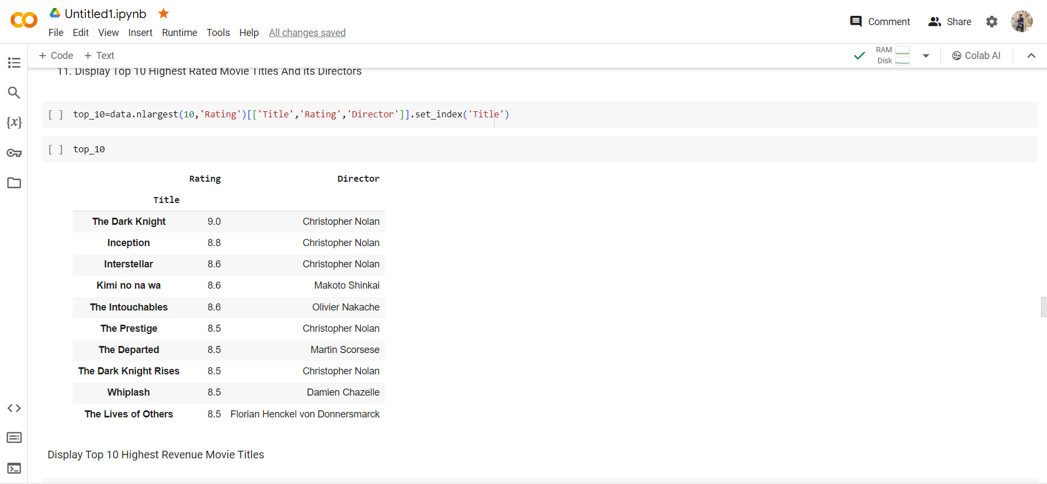
implementing of data sets

Slide 7

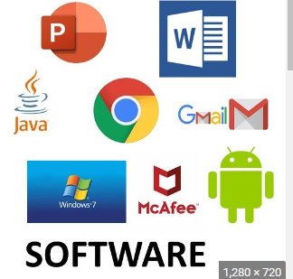
System approach
The system approach section outilne the overall ststegy and methodology for developing and implementing of dataset, data analysis, Pandas project.
Hardware: Intel(R) Core(TM) i5-7020U CPU @ 2.30GHz
64-bit operating system, x64-based processor, version 22H2 network connection connected to Wifi, network speed to download 10Mbps with A ram size of 6GB
Software: A operating system with the required of software resourcre of
Windows or MacOs For Dataset information used Kaggle
And I used Google collab Ai for implemenation of project.
\

Slide 8
Statistical techniques
Statistical techniques use measurements to approximate a model. For statistical techniques Python Pandas Project I collected the data from kaggle.com
import pandas as pd from pandas
import seaborn as sns from data visualisation
data.head(10) from top 10 dataset
data.info() Dataset Like Total Number Rows, Total Number of Columns, Datatypes of Each Column And Memory Requirement
dup_data=data.duplicated().any() for any duplicate data

Slide 9
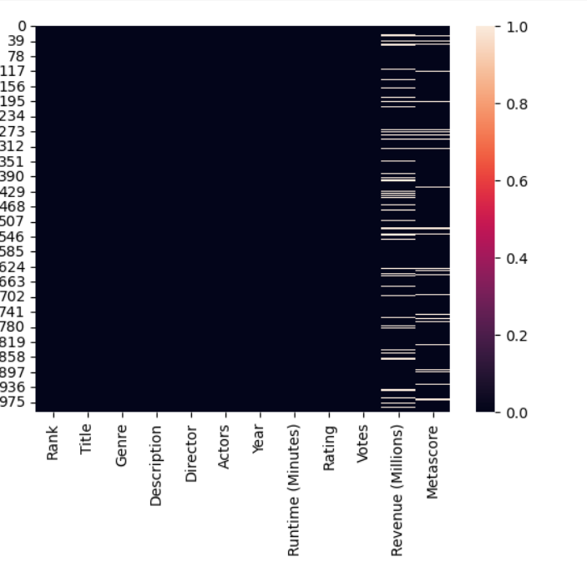
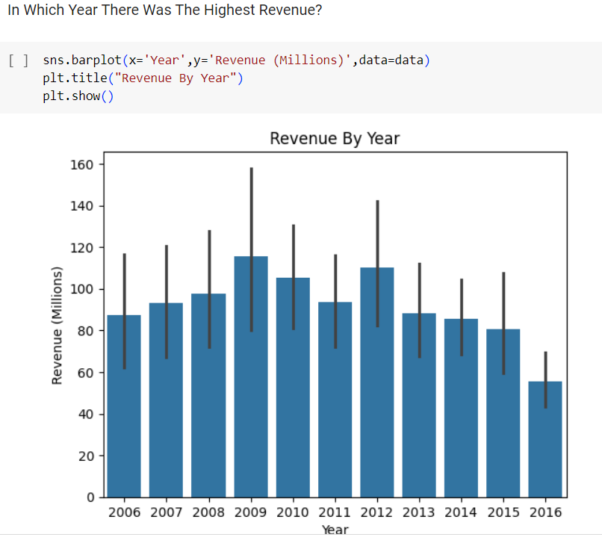
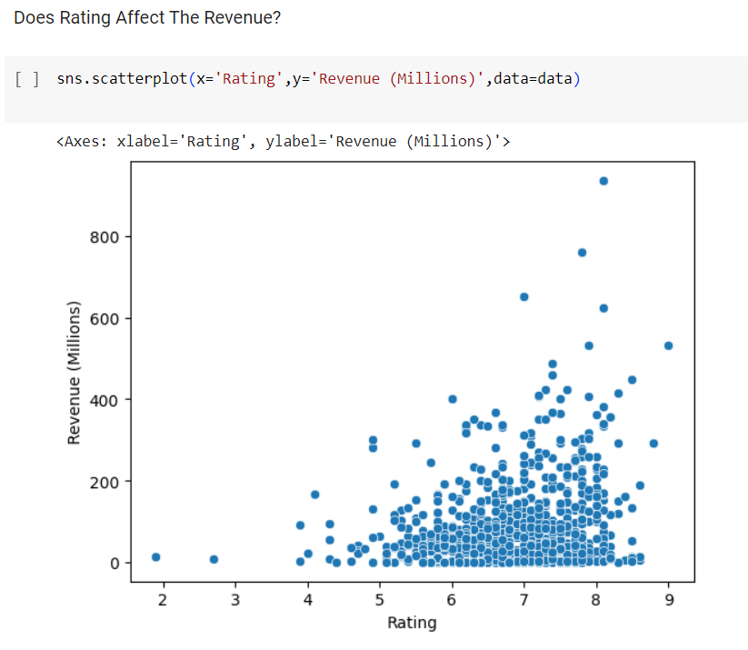
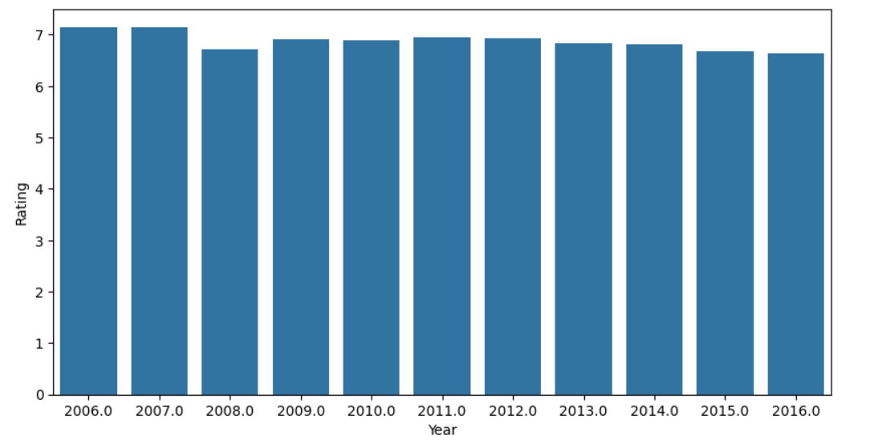
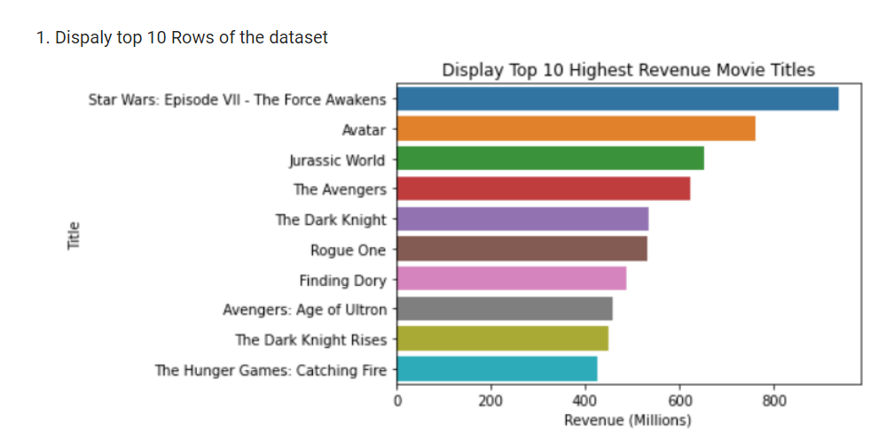
Results

Slide 10

Conclusion
"Our data analytics project aimed to analyze IMDB Data from 2006 to 2016 a data set of 1000 popular movies on Imdb in the last 10 years to uncover insights and trends. Through rigorous analysis of the dataset, we identified key patterns and correlations, providing valuable insights for informed decision-making in data analytics .

Slide 11
Future scope
In the future, Python pandas is poised to advance significantly in several key areas. Enhanced performance optimization will enable more efficient handling of larger datasets, while increased support for big data frameworks will facilitate scalability. The addition of new features for advanced analysis, such as time series and machine learning integration, will broaden pandas' capabilities. Tighter integration with data visualization libraries will improve data exploration and presentation. Cross-platform compatibility enhancements and improvements in user experience will make pandas more accessible and user-friendly.
Overall, the future of Python pandas holds promise for continued growth and evolution in meeting the diverse needs of data professionals.

Slide 12
references
kaggle dataset
kaggle Imdb dataset
goggle collab link
pandas download
pandas in kaggle

Slide 13
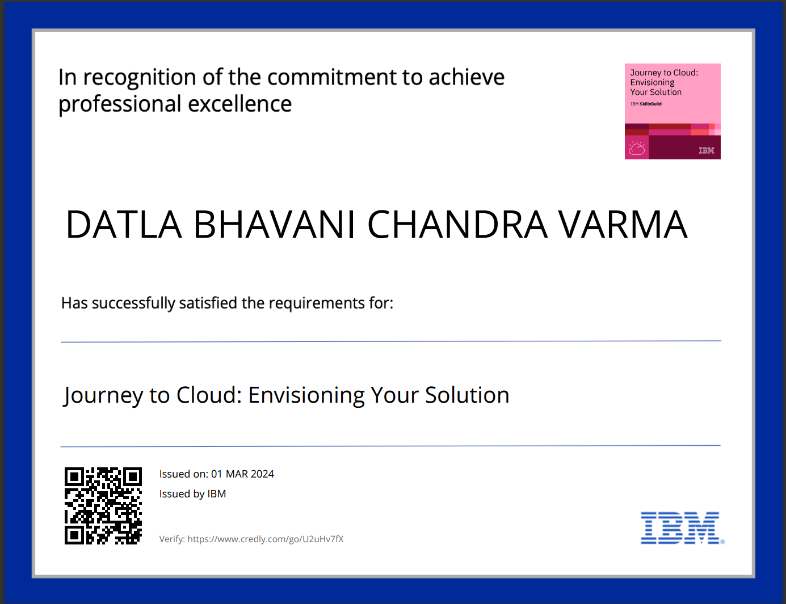
certificate of Journey to Cloud: Envisioning Your Solution

Slide 14
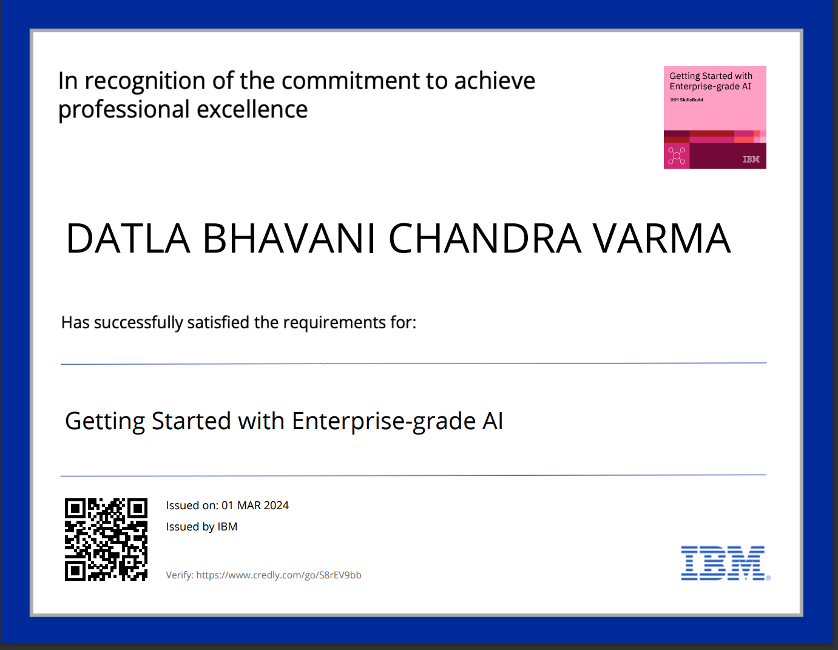
certificate of Getting Started with Enterprise-grade AI

Slide 15


